Slide 1
Weekly Update #23
Gijs Admiraal

Slide 2
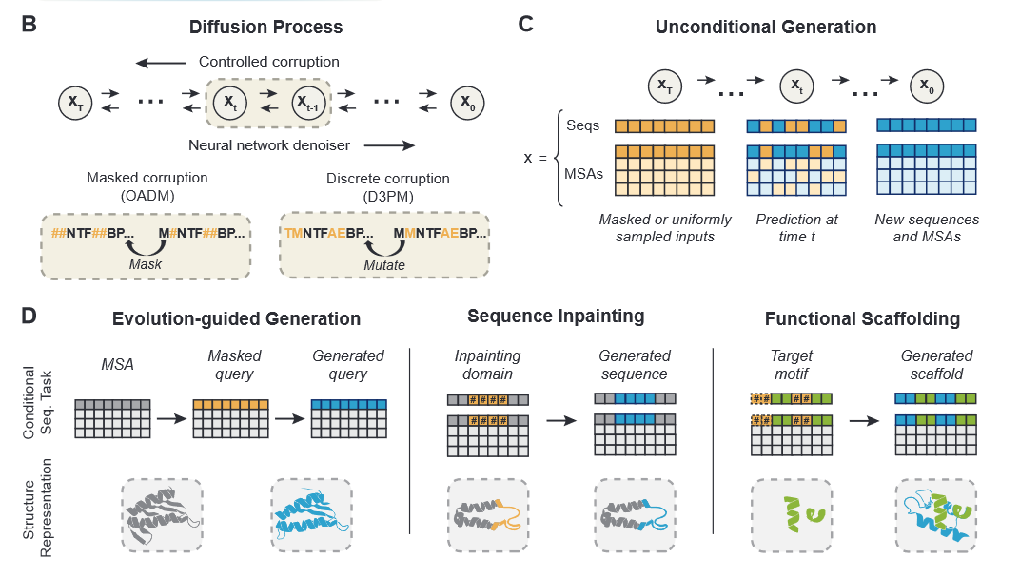
EvoDiff¹
De novo protein sequence design through discrete diffusion
Two types of generation:
Unconditional generation
Evolution-guided generation

Slide 3
EvoDiff¹
De novo protein sequence design through discrete diffusion
Two types of generation:
Unconditional generation
Evolution-guided generation
Two types of frameworks:
D3PM
With uniform and BLOSUM62 transition matrices
Order-Agnostic Auto-Regressive (OADM) diffusion model
Similar to D3PM with absorbing state transition matrices
Trained on UniRef50
Denoising model: ByteNet-style CNN architecture
38M and 640M parameters

Slide 4
ByteNet
Decoder is either
A Conv1D layer
A Linear feed forward if shared weights is enabled
Their setup is with no shared weights
ByteNetLMTime
ByteNet
Embedder
Normalization
Decoder
Optional: shared weights

Slide 5


ByteNetEmbedder
dim=8
dim=1
Timestep
Encoder
dim=1024
$$t$$
ByteNet
Block 1
Up
Embedder
(Conv1D)
ByteNet
Block 1
ByteNet
Block 1
ByteNet
Block_n
dim=8
+
Input
Embedder
dim=n_tokens
$$x_{t}$$

Slide 6


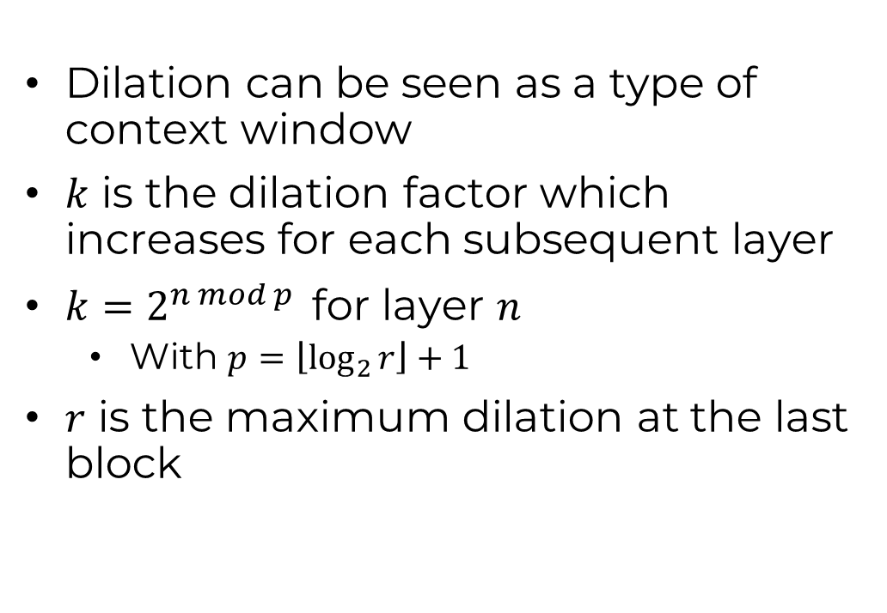

ByteNet Block
LayerNorm
GeLu
$1×1$ Convolution
Dilation can be seen as a type of context window
$k$ is the dilation factor which increases for each subsequent layer
$k=2^{n mod p }$for layer $n$
With $p=\left\lfloor \log_{2}{r}\right\rfloor +1$
$r$ is the maximum dilation at the last block
LayerNorm
GeLu
$1×k$ Dilation Convolution
LayerNorm
GeLu
$1×1$ Convolution
+

Slide 7
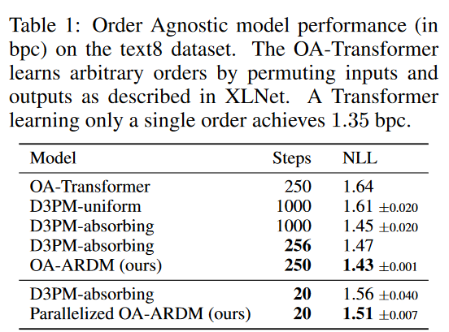
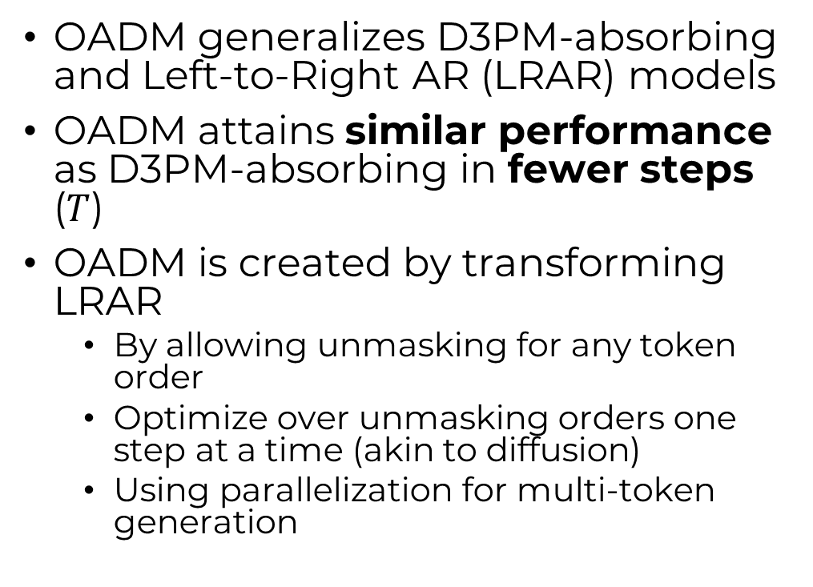
OADM vs D3PM²
OADM generalizes D3PM-absorbing and Left-to-Right AR (LRAR) models
OADM attains similar performance as D3PM-absorbing in fewer steps ($T$)
OADM is created by transforming LRAR
By allowing unmasking for any token order
Optimize over unmasking orders one step at a time (akin to diffusion)
Using parallelization for multi-token generation

Slide 8
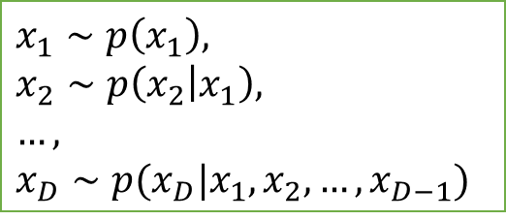
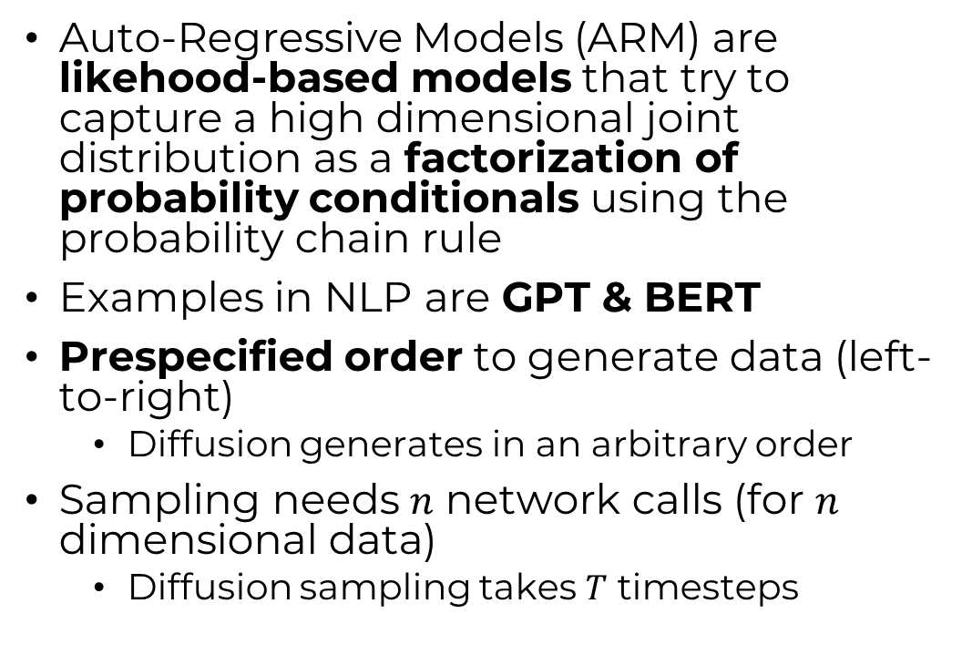
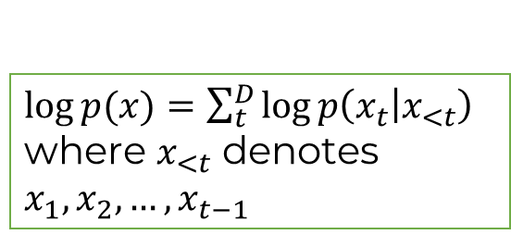
Auto-Regressive Models (ARM)
Auto-Regressive Models (ARM) are likehood-based models that try to capture a high dimensional joint distribution as a factorization of probability conditionals using the probability chain rule
Examples in NLP are GPT & BERT
Prespecified order to generate data (left-to-right)
Diffusion generates in an arbitrary order
Sampling needs $n$ network calls (for $n$ dimensional data)
Diffusion sampling takes $T$ timesteps
$\log{p(x)}=\sum_{t}^{D}{\log{p\left(x_{t} | x_{<t}\right)}}$
where $x_{<t}$ denotes $x_{1},x_{2},…,x_{t−1}$
$$x_{1}∼p\left(x_{1}\right),$$
$$x_{2}∼p\left(x_{2} | x_{1}\right),$$
$$…,$$
$$x_{D}∼p(x_{D}|x_{1},x_{2},…, x_{D−1})$$

Slide 9
Auto-Regressive Models (ARM)
Auto-Regressive Models (ARM) are likehood-based models that try to capture a high dimensional joint distribution as a factorization of probability conditionals using the probability chain rule
Examples in NLP are GPT & BERT
Prespecified order to generate data (left-to-right)
Diffusion generates in an arbitrary order
Sampling needs $n$ network calls (for $n$ dimensional data)
Diffusion sampling takes $T$ timesteps

Slide 10

Auto-Regressive Models (ARM)
Auto-Regressive Models (ARM) are likehood-based models that try to capture a high dimensional joint distribution as a factorization of probability conditionals using the probability chain rule
Examples in NLP are GPT & BERT
Prespecified order to generate data (left-to-right)
Diffusion generates in an arbitrary order
Sampling needs $n$ network calls (for $n$ dimensional data)
Diffusion sampling takes $T$ timesteps
$$p(x_{1})$$

Slide 11

Auto-Regressive Models (ARM)
Auto-Regressive Models (ARM) are likehood-based models that try to capture a high dimensional joint distribution as a factorization of probability conditionals using the probability chain rule
Examples in NLP are GPT & BERT
Prespecified order to generate data (left-to-right)
Diffusion generates in an arbitrary order
Sampling needs $n$ network calls (for $n$ dimensional data)
Diffusion sampling takes $T$ timesteps
$$p({x_{2}|x}_{1})$$

Slide 12

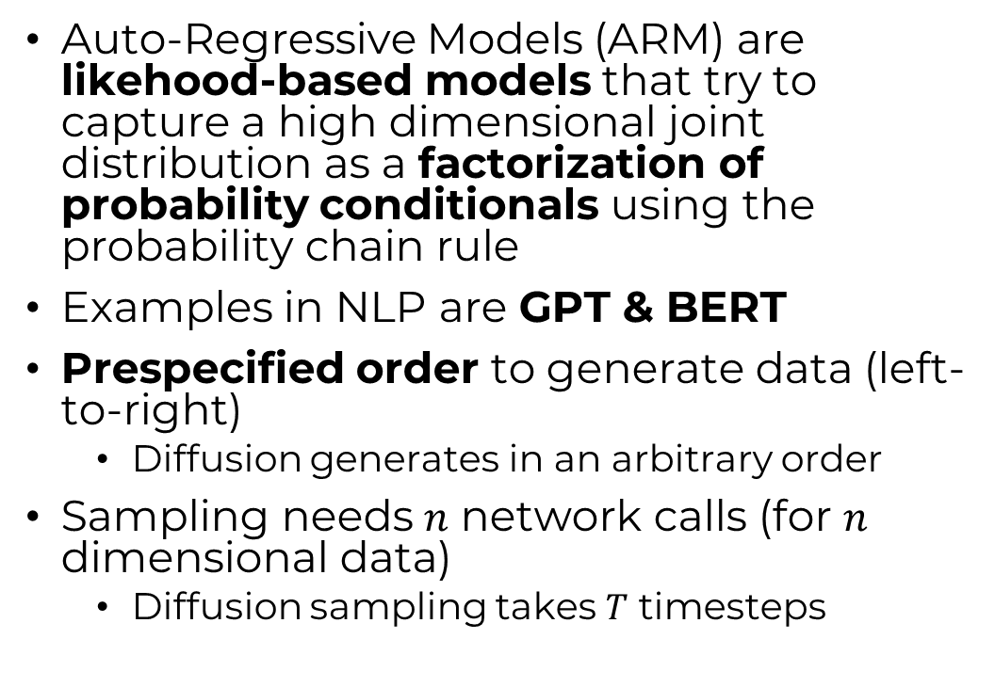
Auto-Regressive Models (ARM)
Auto-Regressive Models (ARM) are likehood-based models that try to capture a high dimensional joint distribution as a factorization of probability conditionals using the probability chain rule
Examples in NLP are GPT & BERT
Prespecified order to generate data (left-to-right)
Diffusion generates in an arbitrary order
Sampling needs $n$ network calls (for $n$ dimensional data)
Diffusion sampling takes $T$ timesteps
$$p({x_{3}|x}_{1},x_{2})$$

Slide 13

Auto-Regressive Models (ARM)
Auto-Regressive Models (ARM) are likehood-based models that try to capture a high dimensional joint distribution as a factorization of probability conditionals using the probability chain rule
Examples in NLP are GPT & BERT
Prespecified order to generate data (left-to-right)
Diffusion generates in an arbitrary order
Sampling needs $n$ network calls (for $n$ dimensional data)
Diffusion sampling takes $T$ timesteps
$$p({x_{4}|x}_{1},x_{2},x_{3})$$

Slide 14
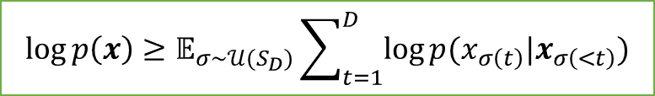
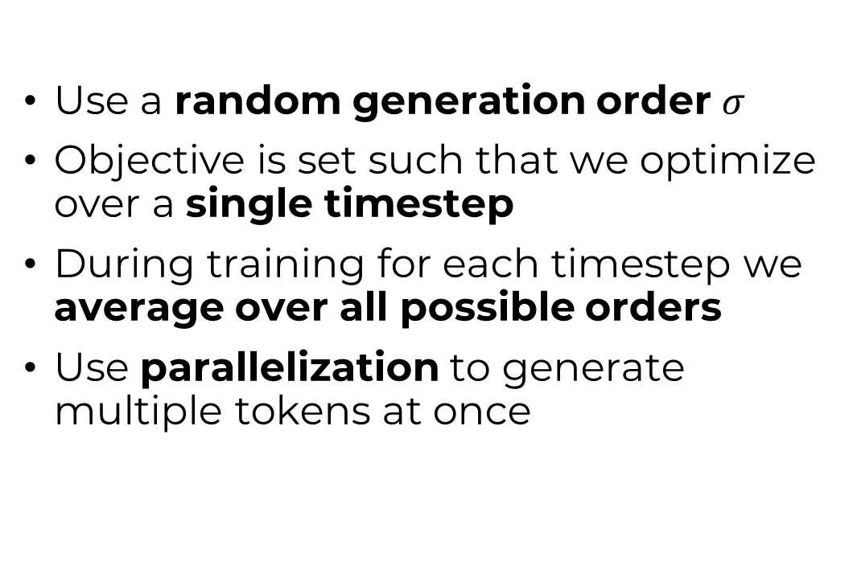
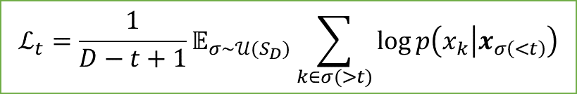
Order Agnostic AR Diffusion Models (OARDM)
Use a random generation order $σ$
Objective is set such that we optimize over a single timestep
During training for each timestep we average over all possible orders
Use parallelization to generate multiple tokens at once
$$\log{p\left(x\right)≥𝔼_{σ∼𝒰(S_{D})}\sum_{t=1}^{D}{\log{p(x_{σ\left(t\right)}|x_{σ\left(<t\right)}})}}$$
$$\log{p\left(x\right)≥𝔼_{t∼𝒰\left(1,…,D\right)}[D⋅ℒ_{t}]}$$
$$ℒ_{t}=\frac{1}{D−t+1}𝔼_{σ∼𝒰(S_{D})}\sum_{k∈σ(>t)}{\log{p\left(x_{k} | x_{σ\left(<t\right)}\right)}}$$

Slide 15
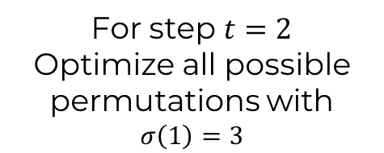
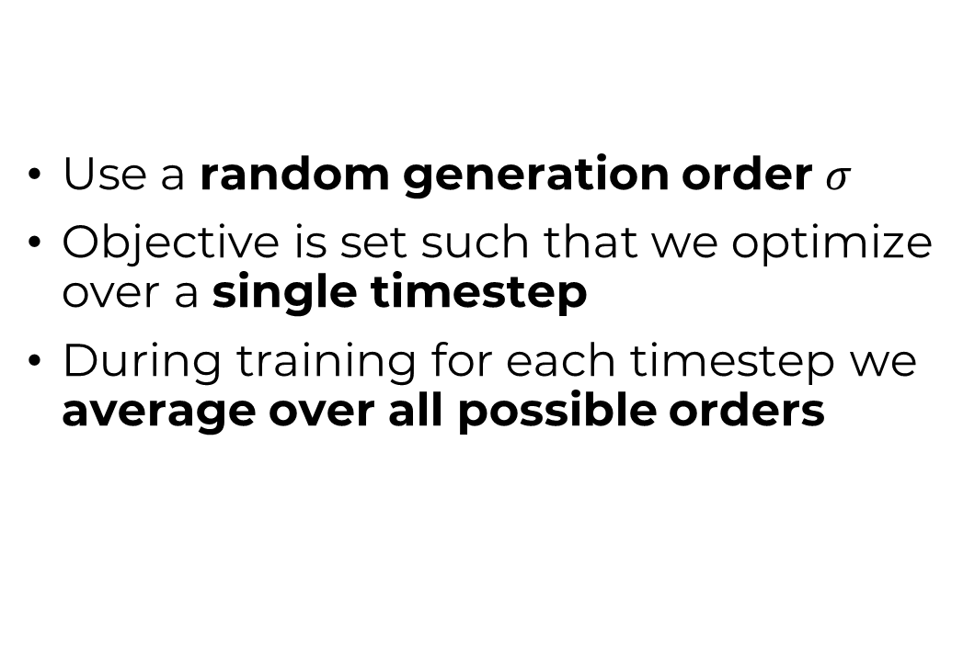
Order Agnostic AR Diffusion Models (OARDM)
Use a random generation order $σ$
Objective is set such that we optimize over a single timestep
During training for each timestep we average over all possible orders
Training
For step $t=2$
Optimize all possible permutations with $σ\left(1\right)=3$

Slide 16
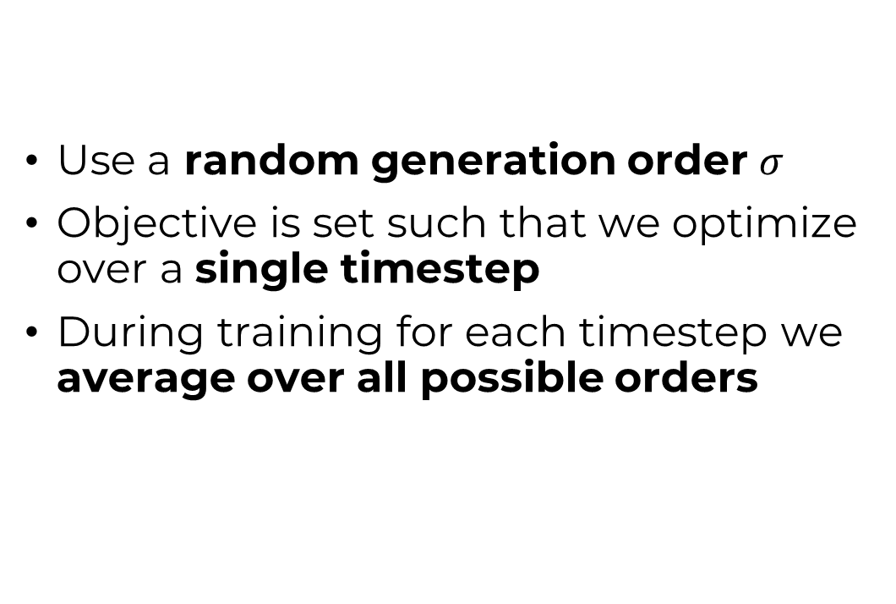
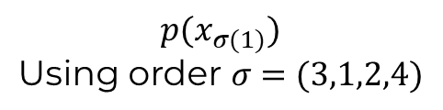
Order Agnostic AR Diffusion Models (OARDM)
Use a random generation order $σ$
Objective is set such that we optimize over a single timestep
During training for each timestep we average over all possible orders
Sampling
$$p(x_{σ(1)})$$
$$\text{Using} \text{order} σ=(3,1,2,4)$$

Slide 17
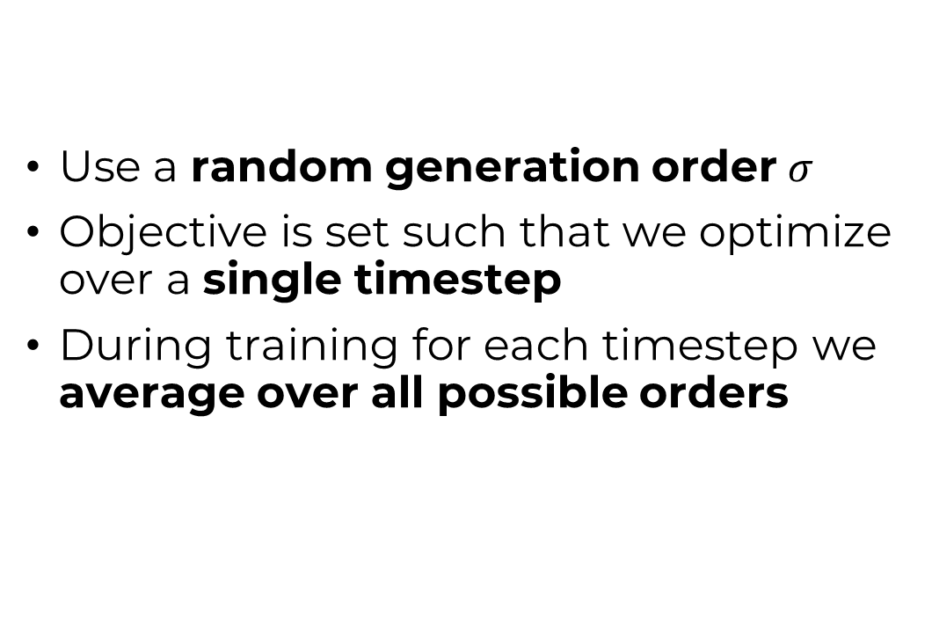
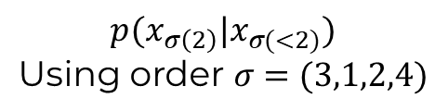
Order Agnostic AR Diffusion Models (OARDM)
Use a random generation order $σ$
Objective is set such that we optimize over a single timestep
During training for each timestep we average over all possible orders
Sampling
$$p(x_{σ\left(2\right)}|x_{σ(<2)})$$
$$\text{Using} \text{order} σ=(3,1,2,4)$$

Slide 18
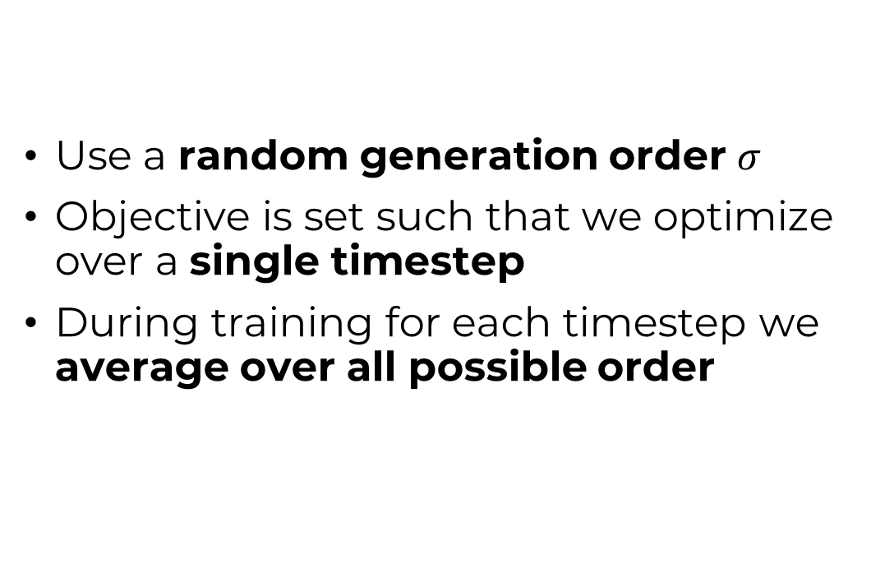
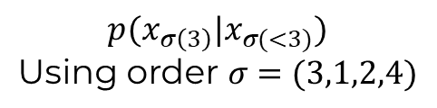
Order Agnostic AR Diffusion Models (OARDM)
Use a random generation order $σ$
Objective is set such that we optimize over a single timestep
During training for each timestep we average over all possible order
Sampling
$$p(x_{σ\left(3\right)}|x_{σ(<3)})$$
$$\text{Using} \text{order} σ=(3,1,2,4)$$

Slide 19
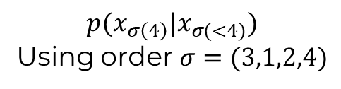
Order Agnostic AR Diffusion Models (OARDM)
Use a random generation order $σ$
Objective is set such that we optimize over a single timestep
During training for each timestep we average over all possible order
Sampling
$$p(x_{σ\left(4\right)}|x_{σ(<4)})$$
Using order $σ=(3,1,2,4)$

Slide 20
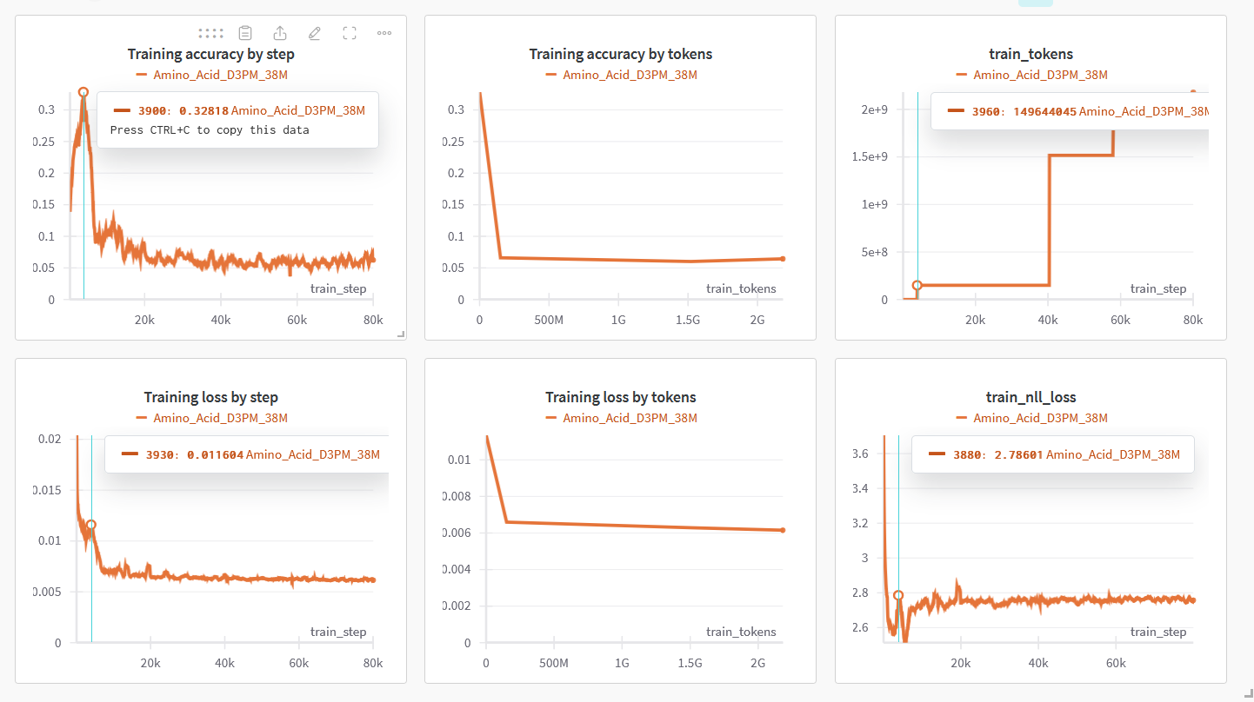
Training
D3PM-uniform with ByteNet-38M
Trained for ± 76 hours
Metrics are regularized by number of tokens seen
Accuracy is misbehaving

Slide 21
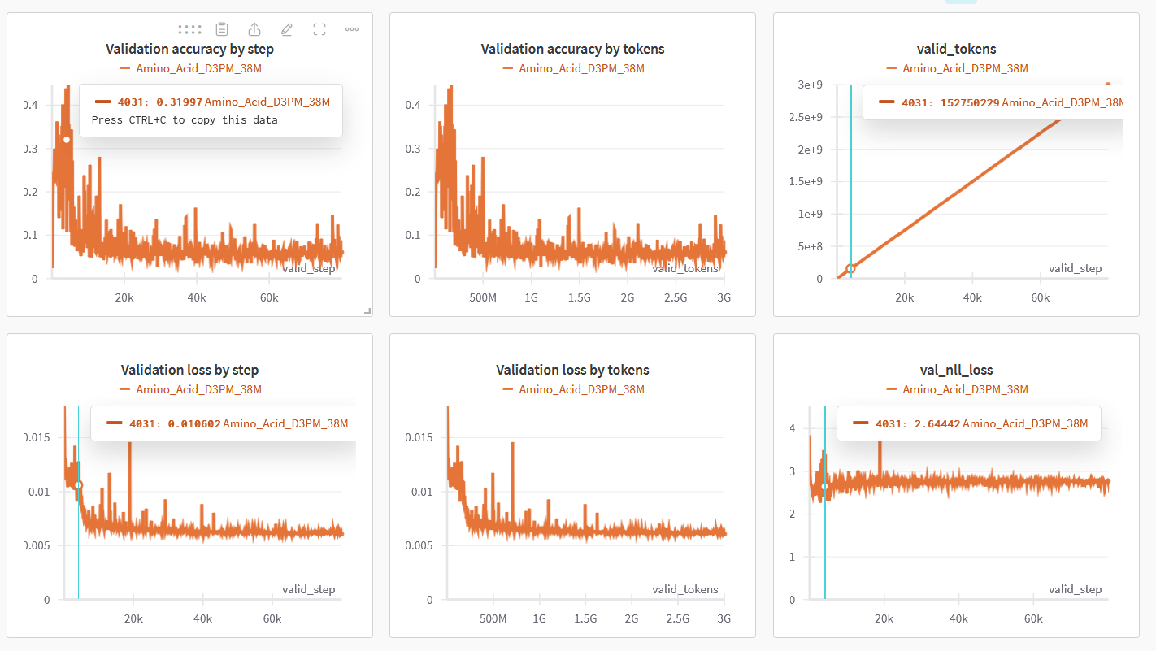
Validation
D3PM-uniform with ByteNet-38M
Trained for ± 76 hours
Metrics are regularized by number of tokens seen
Accuracy is misbehaving

Slide 22
New plan/progress
Use their D3PM-uniform implementation together with ByteNet
ByteNet also does seq2seq like T5
My original code problems were with T5
Skip the OADM framework
Deviates maybe too much from original plan
We keep the flexibility of D3PM framework
Cannot find how/if they did parallelization
Train first on small model (38M)
Maybe at the end train on larger model (640M)

Slide 23
New plan/progress
Training on aa sequences
Accuracy misbehaving
Training on all-atom sequences
Getting the tokenization and dataloader to work
Training on multi-GPU does not want to work
So skipping for now
Really want to try to get absorbing state to work

Slide 24
Notes
Train on my own uniref dataset!
Check accuracy

